Slide 1
PHP/MySQL - 7
Login and Change password using the password table

Slide 2
We will
Revise Session Variables
Login
Change Password of the user that is logged in

Slide 3
What is a PHP Session?
When you work with an application, you open it, make some changes, and then you close it.
On the internet there is one problem: the web server does not know who you are or what you do, because the HTTP address doesn't maintain state.

Slide 4
PHP Sessions
An alternative way to make data accessible across the various pages of an entire website is to use a PHP Session.
A session creates a file in a temporary directory on the server where registered session variables and their values are stored.

Slide 5
PHP Sessions in W3Schools
PHP Sessions

Slide 6
Login and Change Password
Try the login screen

Slide 7
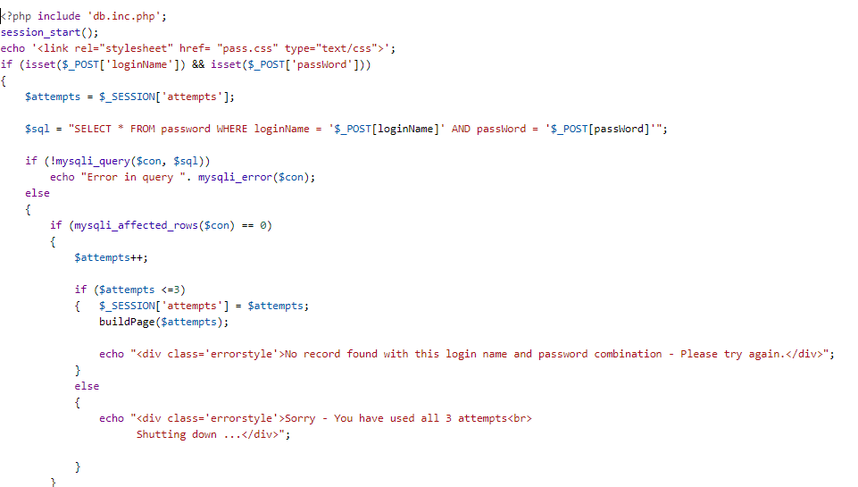
loginScreen.php

Slide 8
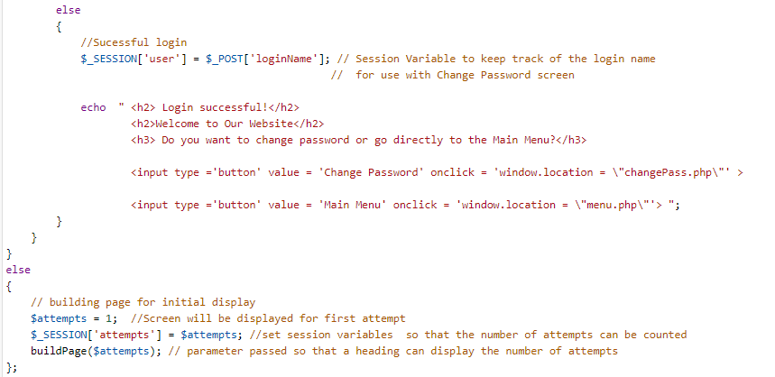
loginScreen.php (continued)

Slide 9
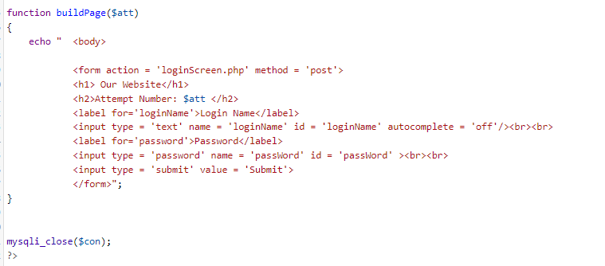
loginScreen.php (continued)

Slide 10
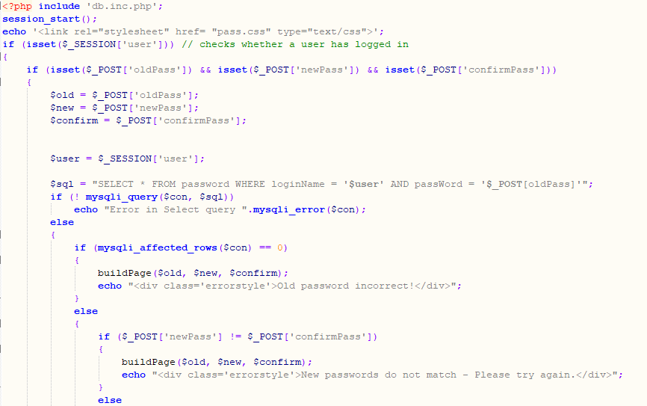
changePass.php

Slide 11
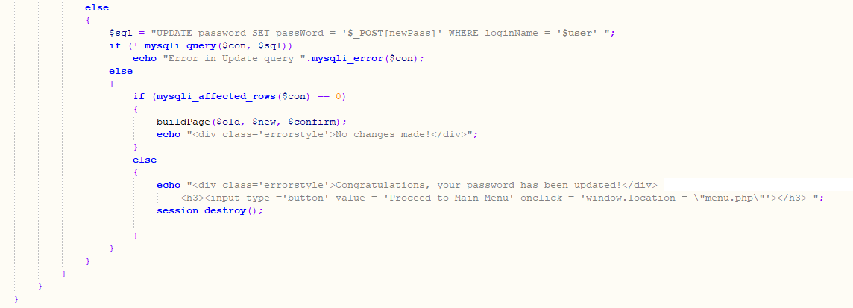
changePass.php (continued)

Slide 12
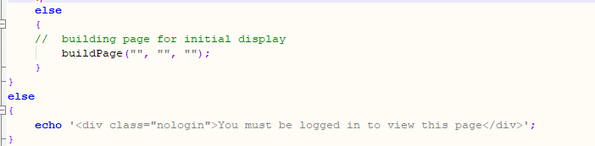
changePass.php (continued)

Slide 13
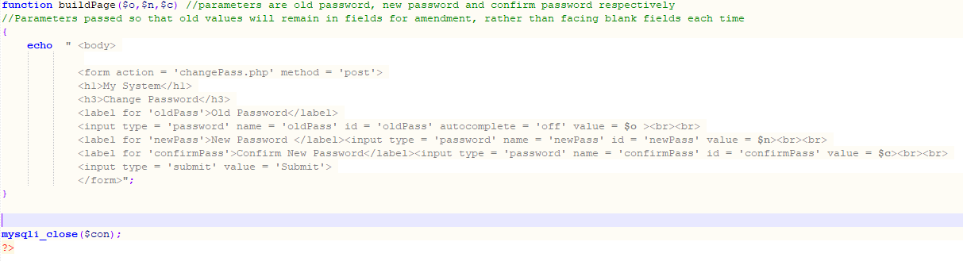
changePass.php (continued)

Slide 14
Current values on my table!
If you have a problem, email me
loginName PassWord
Farrell Moloney
Hayes mARY
Moloney Catherine
Smith Maggie

